Slide 1





Clár 2026

Slide 2

Webinar MARCH 24TH
Clár 2026 Programme
Fáilte

Slide 3


Slide 4
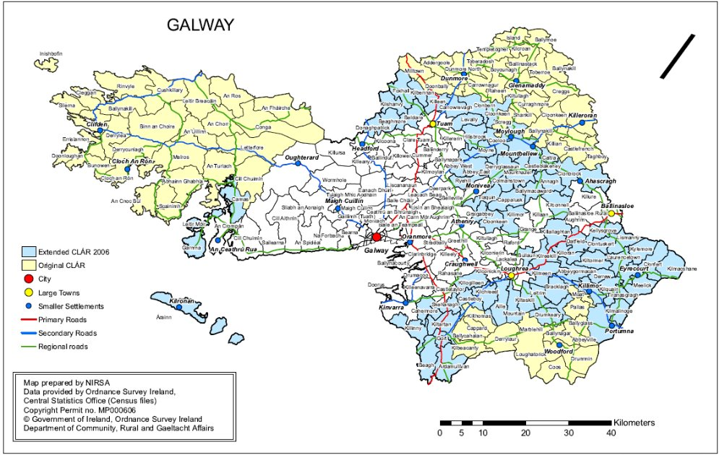

Slide 5
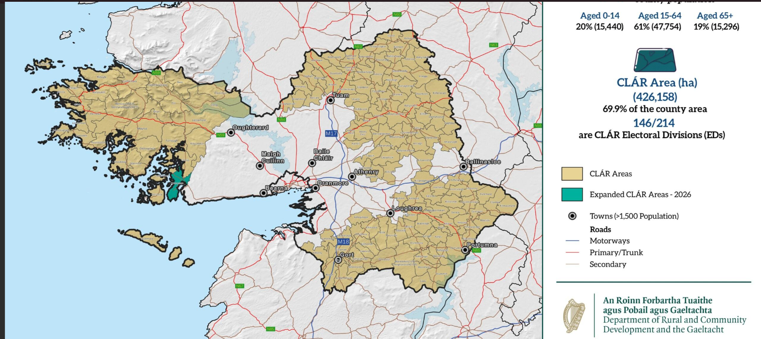

Slide 6
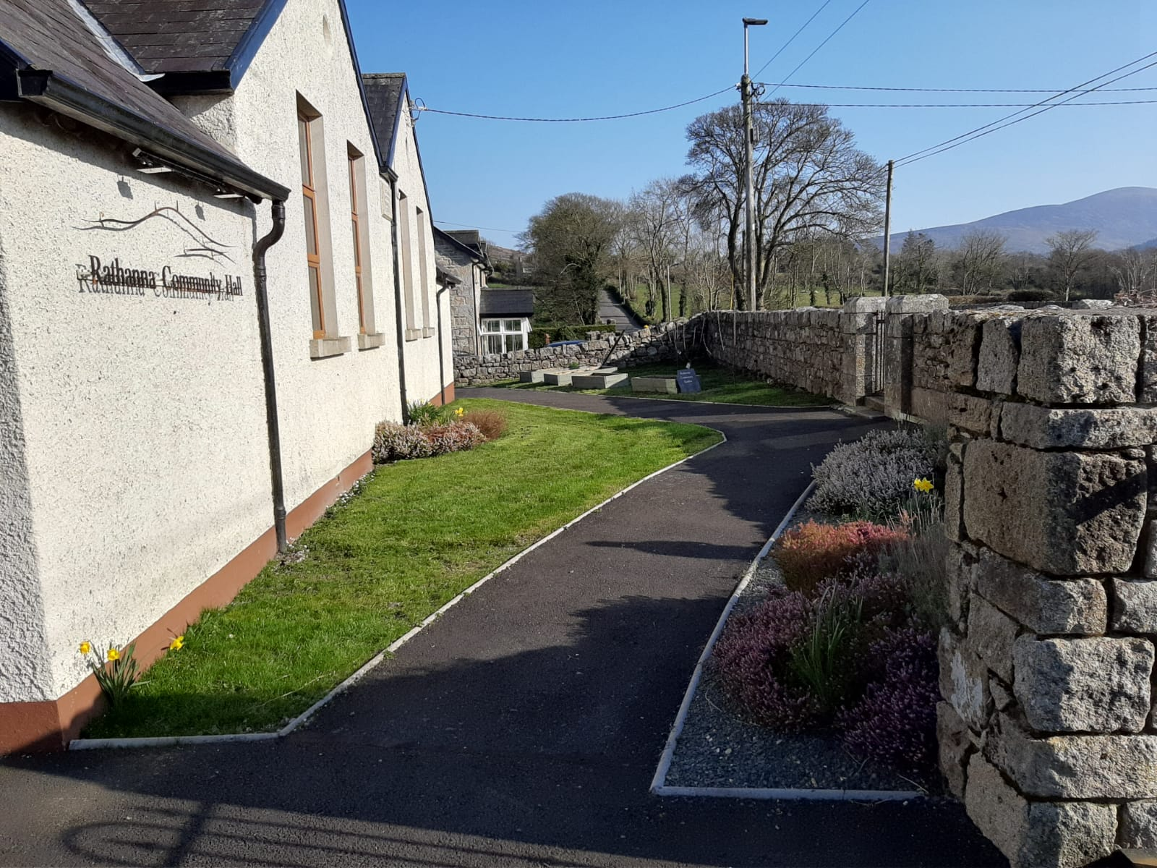
CLÁR 2026 Measures
The measures being funded under the programme are:
Measure 1: Developing Community Facilities & Amenities

Slide 7
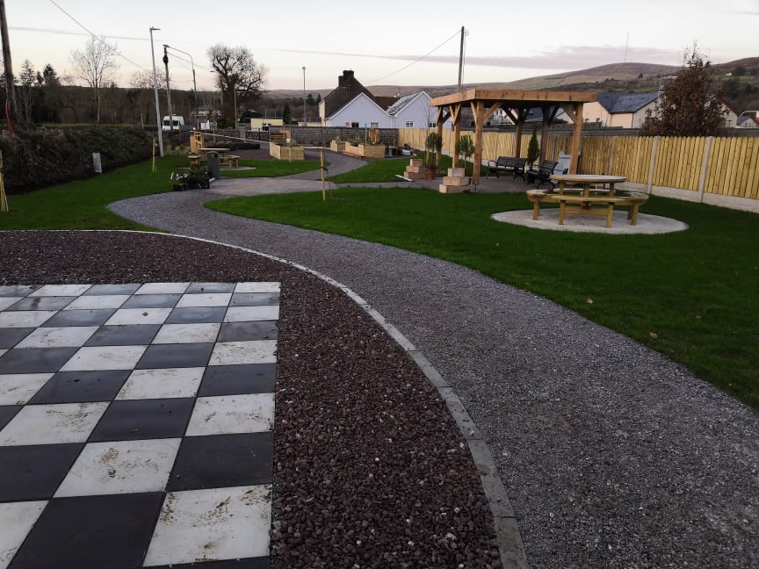
CLÁR 2026
Budget is €12 million across all measures for clár 2026.
Applications for Measure 1 via Local Authority
Applications for Measures 2 and 3 direct to the DRCDG
Outlines and forms are available on www.gov.ie/drcdg
Min. Grant of €5,000 & Max. Grant €65,000 under Measure 1

Slide 8
Measure 1: Developing Community Facilities and Amenities
Skateboard Parks
Outdoor Toilet Facilities
Measure 1 will support a variety of capital interventions provided that they contribute to the enhancement of existing, and/or the development of new, accessible Community Facilities/Amenities.
Up to 16 project applications may be selected by the LA for onward submission to the Department for its consideration.
The facilities and amenities must be freely available (nominal fee acceptable) to all members of the community without any additional restrictions or requirements being imposed.
A minimum grant of €5,000 and maximum grant of €65,000 will apply to this measure.
The scheme will provide up to 90% of the cost. 10% cash contribution required.
Community Gardens
Sensory Gardens
Playgrounds
Spectator Stands
Community Gyms
Car Parking Facilities
Small Scale Renovation Works
Basketball
/Tennis Courts

Slide 9
Projects Funded Under Clár
Small scale renovation works to community facilities open to the wider community such as community centres/sports centres/clubhouses of sporting groups/youth centres/men’s sheds etc. This includes external works such as parking and accessibility enhancements
Multi-use gaming areas (MUGAs)/Astro-turf facilities including upgrades (see information box in respect of astro turf surfaces below)
Playgrounds/skateboard parks/pump tracks/cycling tracks/teenage spaces
Walking/running /athletics tracks
Handball alleys/tennis courts/basketball courts/cricket grounds/ outdoor bowling areas
Community gyms/community cinemas
Sensory gardens/Community gardens/ allotments/ biodiversity planting
Access to unique local heritage sites / areas of natural beauty
Enhanced outdoor toilet and changing facilities
Car parking
Community focussed traffic safety measures
Improving access at sports grounds e.g. development/upgrade of spectator stands at local sports grounds with a particular focus on improving access for people of all abilities and ages
Toilets/showers in community facilities but not sports team changing rooms or showers.

Slide 10
Measure 1 - Selection of Projects – LA
Must be in a CLÁR area; refer to the DED’s list and County Maps
Eligible applicants – Schools, Community Groups, LDCs and LAs
Clear need and rationale for the project and consistent with County Development Plans and LECP
Evidence that necessary permissions, ownership/lease, if applicable are in place
Planning permission must be in place or in train with reference number provided.

Slide 11
Measure 1 - Selection of Projects – LA
Full estimated costings including administration/professional fees that are reasonable and proportionate to the overall cost of the project.
Confirmation of match funding (10%) in place and the breakdown of match funding (if applicable)
Open to the public without appointment and necessary insurance in place
In the assessment process, DRCDG will prioritise project applications that are in accordance with the UN Sustainable Development Goals (SDGs) and the Climate Action Plan.

Slide 12
Application Process
M1 – Up to 14 applications per LA with indicative priority except those in Gaeltacht may submit up to 16.
Completed applications for each project signed by the Director of Services with -
- Accurate costings with full breakdown of costs
- Funding sought (max. 90%) and Match Funding (min. 10%).
- Admin/Professional fees outlined (if applicable)
EOI/Application Overview (MS Excel) with all fields populated and signed by the DoS.

Slide 13
Projects
16 projects under Measure 1, may be shortlisted by Galway County Council for submission to the Department of Community and Rural Development.
12 applications seeking funding of between €5,000 and €65,000
2 applications seeking funding of between €5,000 and €100,000
2 of which applications may be from Gaeltacht Community areas.
Measure 1 will support a variety of capital projects provided that they contribute to the enhancement of existing, and/or the development of new, accessible Community Recreation Facilities.

Slide 14
Other Considerations
Display and encourage Leave no Trace Principles
UN Sustainable Development Goals (17 SDGs) and the Climate Action Plan– encourage and promote an enhancement of biodiversity when reinstating/landscaping areas e.g. native pollinator plants
Signage/Promotion – Photo(s) of completed project with final drawdown should include evidence of signage erected referencing DRCDG funding
Please reference the Departments Branding Guidelines for further information in relation to signage requirements.

Slide 15
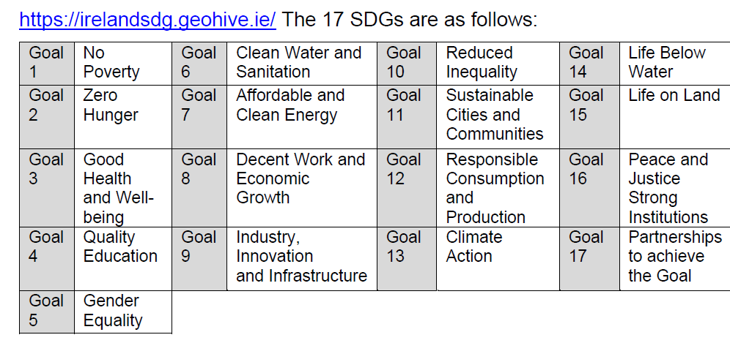

Slide 16
Other Considerations
Drawdown submitted on the Annex 4, listing invoices.
Agresso/Financial Management System printout required for all drawdowns
Case Studies - DRCDG requires case studies of completed projects which may be used for promotional purposes. Ensure to submit photos of all completed elements as approved when submitting the final claim
Must adhere to the Public Spending Code.
The Department is continually encouraging development of inclusive facilities and amenities that are accessible for all abilities where possible and appropriate.

Slide 17
ASSESSMENT
Rationale and Need
Deliverability
Alignment to Policy
Value for Money
Accessibility
Quality of Application
Management and Sustainability

Slide 18
Selection Criteria
evidence that all necessary permissions are in place at the time of application.
Where applicant does now own the premises, evidence, that minimum 7-year lease/licence is in place
comprehensive estimated costs including local authority professional fees, if applicable
evidence that match funding is in place at time of application
evidence that the funded project will be open to the public without appointment, and that the necessary insurance is in place
a single facility (not multiple locations).
only 1 application per organisation/facility.
project must be accessible to all.
projects must be shovel ready.
The measure will be implemented via the local authorities. Projects proposed to the Department by the local authority must be selected on the basis of:
being located in a CLAR area
an application by a community or voluntary organisation, school or local development company to the local authority
clear evidence of need
alignment with the County Development Plan/Town Plan, the Local Economic and Community Plan, and the Climate Action Plan

Slide 19
Changes in 2026
Expressions of Interest list to be submitted along with the Application Overview. This is to determine the level of interest in the Measure and the distribution across the LA area.
In line with other Schemes, in the case of capital works, the applicant must own or have a 15 year lease in place at the time of application.
If the project involves works on buildings or lands that are not in the ownership of the grantee, a minimum of 7 years remaining on a lease/licence must be in place from date of application.
Completion and drawdown date for successful projects extended by 6 months from 12 months to 18 months approximately to allow for a more substantial amount of time to complete the works. This is intended to alleviate some of the additional administrative burden of submitting extension requests and change of purpose forms.

Slide 20
Changes to the National Public Procurement Guidelines
The threshold is now €65,000 (exclusive of VAT), at which contracting authorities are required to advertise all contracts for goods and services on eTenders
The threshold is now €200,000 (exclusive of VAT), at which contracting authorities are required to advertise all contracts for works on eTenders
Notwithstanding the above, contracting authorities are required to publish contract award information for all procurements over €25,000 (exclusive of VAT), on the eTenders website on completion of the award (whether the procurement was advertised on eTenders or not).
The OGP has created a web page where public bodies can find further information on the circular, including FAQs.
gov.ie - New circular to assist SMEs in Public Procurement (www.gov.ie)

Slide 21
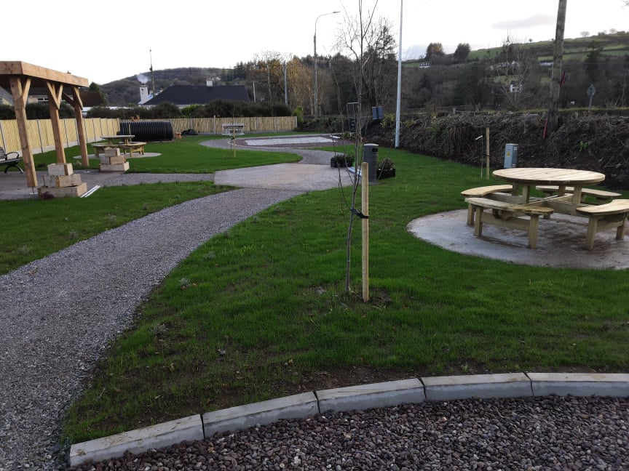
Important Dates
Application deadline on Submit
Measure 1: 15th May 2026
Indicative Date for Project Approvals: summer onwards from 2026
Indicative Project Completion and Drawdown: 30th of May 2027

Slide 22
Fully completed forms for Measure 1 must be returned to Galway County Council
√ by 11 P.M. on Friday the 15th May via https://galwaycoco.submit.com
√ Further Information: Galway County Council
√ Queries Community & Rural Development Unit, Galway County Council
√ Email: clar@galwaycoco.ie
√ Tel: 091-509396/091-509266/091-509334

Slide 23




Further information available on services Community and Rural Development Grant Schemes under Clár
www.galway.ie
Make an Applicaiton on Submit.com under the Clár grant scheme 2026
clar@galwaycoco.ie
Tel: 091-509396/091-509266/091-509334
Thank you for your attendance.

